Slide 1


Slide 2

“The establishment and use of sound engineering principles in order to obtain economically developed software that is reliable and works efficiently on real machines.”
-Fritz Bauer(1968)
“A discipline whose aim is the production of quality software, software that is delivered on time, within budget, and that satisfies its requirements.”
-Stephen Schach

Slide 3
Software Engineering is a systematic approach to the design, development, operation, and maintenance of a software system.

Slide 4

Software is more than just a program. It consists of programs, documentation of any facet of the program and the procedures used to setup and operate the software system.
Any program is a subset of software and it becomes software only if documentation and operating procedure manuals are prepared.
Program is just a combination of source code and object code.

Slide 5

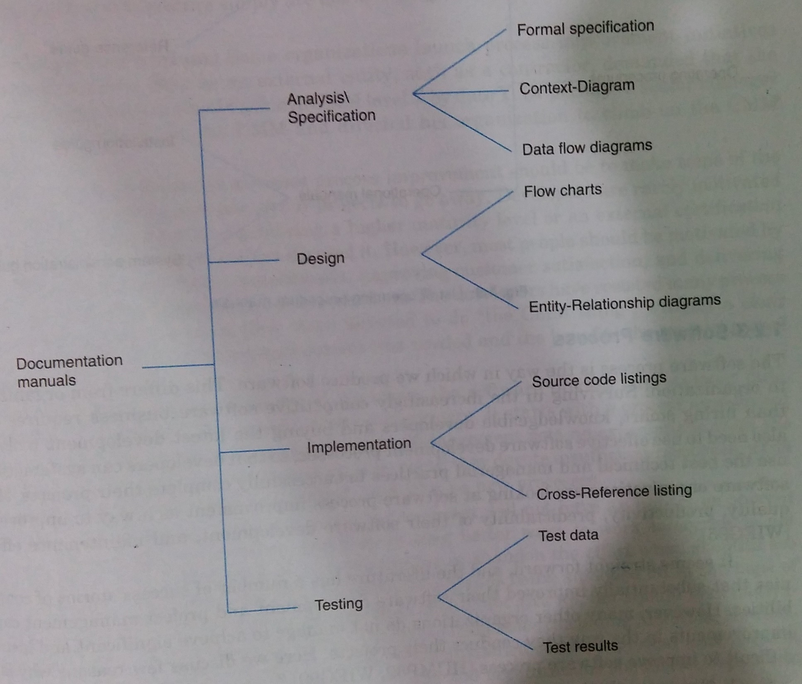

Slide 6
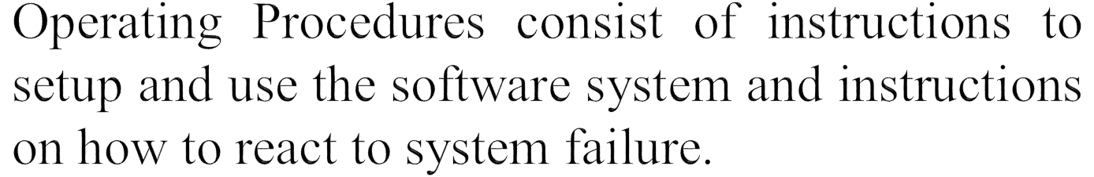

Slide 7

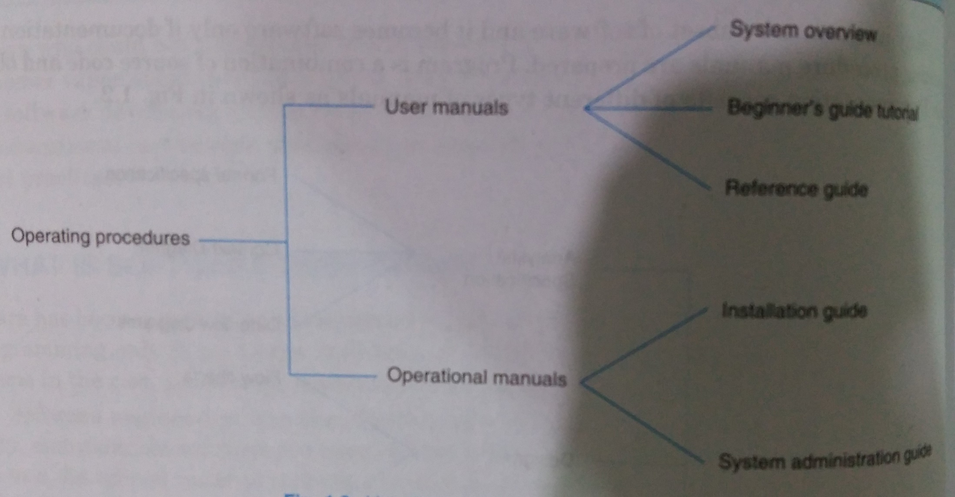

Slide 8

The way of producing software.
Differs from organization to organization.
Its not just about hiring smart, knowledgeable developers and buying the latest development tools.
The use of effective software development processes is also needed, so that developers can systematically use the best technical and managerial practices to successfully complete their projects.

Slide 9
There are many life cycle models and process improvement models.
Depending on the type of project, a suitable model is to be selected.

Slide 10

The software has a very special characteristic e.g., “It does not wear out”.
Its behavior and nature is quite different than other products of human life.
Comparison b/w “constructing a bridge” and “building a software”.

Slide 11
S. No. | Constructing a Bridge | Building a Software
1. | The problem is well understood. | Only some parts of the problem are understood, others are not.
2. | There are many existing bridges. | Every software is different and designed for special applications.
3. | The requirements for a bridge typically do not change much during construction. | Requirements typically change during all phases of development.
4. | The strength and stability of a bridge can be calculated with precision. | Not possible to calculate correctness of a software with existing methods.

Slide 12
S. No. | Constructing a Bridge | Building a Software
5. | When a bridge collapses, there is a detailed investigation and report. | When a program fails, the reasons are often unavailable or even deliberately concealed.
6. | Engineers have been constructing bridges for thousand of years. | Developers have been writing programs for 50 years or so.
7. | Materials (wood, stone, iron, steel) and techniques (making joints in wood, carving stone, casting iron) change slowly. | Hardware and software changes rapidly.

Slide 13
Some other characteristics of software are:
It does not wear out.
Software is not manufactured.
Reusability of components.
Software is flexible.

Slide 14

Software has become integral part of most of the fields of human life. We name a field and we find the usage of software in that field.
System software (e.g., operating system)
Real-time software (e.g., weather forecasting system)
Embedded software (e.g., control unit of power plants)
Business software (e.g., ERP)
Personal computer software (e.g., word processors, computer graphics)

Slide 15
Artificial Intelligence software (e.g., Expert systems, Recommendation Systems)
Web based software (e.g., CGI, HTML, Java, Perl)
Engineering and scientific software (e.g., CAD, CAM, SPSS, MATLAB)

Slide 16

Deliverables and Milestones
Different deliverables are generated during software development. The examples are source code, user manuals, operating procedure manuals, etc.
The milestones are the events that are used to ascertain the status of the project. Finalisation of specification is a milestone. Completion of design documentation is another milestone.

Slide 17
Product and Process
What is delivered to the customer is called a product.
Process is the way in which we produce software.
3. Productivity and Effort
4. Module and Software Components
An independent deliverable piece of functionality providing access to its services through interfaces

Slide 18
5. Generic and Customised Software Products
Generic products are developed for anonymous customers. The target is generally the entire world.
The customized products are developed for particular customers.

